Slide 1
Video Production
Session 10

Slide 2
OVERVIEW
Tripods
Cameras
Camera operation
Composition
Lighting
Magic Trick for practice

Slide 3
TRIPODS
Multi-extension legs
  Set for different heights
Pedestal for cranking up or down for different vertical positions
Camera-mounting head
  Controls for pan and tilt
    Panning handle
    Lock down
  Drag or resistance to prevent uneven or jerky movement
  Bubble levels
Quick-release plate
  Attachment of camera to tripod

Slide 4
TRIPODS
Used to:
  Steady the camera whether zoomed in or out
  Smooth pans and tilts compared to handheld
  Minimize camera movement
  Prevent operator fatigue

Slide 5
CAMERAS
Recording formats
Components
Lens
Connectors
Overview of 3 cameras

Slide 6
RECORDING FORMATS
MiniDV
  Common
  Each tape 60/90 minutes
  Affordable
  Transferring to computer takes real time
DVD
  DVD+R, DVD-R, miniDVD in Sony
  Editing on a computer not always smooth
Hard Drive
  Shooting to digital file directly
  Easily transferred to computer
  Measured in GB
Flash Memory
  Increasingly common
  SD cards
  Easy file transfer

Slide 7
COMPONENTS
Translate or transduce optical image that the lens sees into corresponding video picture
Lens selects portion of the scene and produces optical image of it
Imaging device that converts optical image to electric current
  CCD or charged coupled device often called a chip
  Silicon chip that contains light-sensing pixels
Currents are amplified and processed electronically
Viewfinder reconverts electrical signals into video pictures
  Tube you look into
  LCD panel

Slide 8
LENS
Lens selects portion of the scene and produces optical image of it
  Focal length is a technical measure; usually in millimeters
  Related to how wide or narrow of a view the camera is capable of
  Longer the focal length, the narrower the angle of view and the higher the magnification
  Shorter the focal length, the wider the angle of view and the lower the magnification
    Zooming changes focal length
Aperture is the adjustable center hole of the iris
  Auto-iris means camera will adjust itself by reading light levels in the scene and telling the iris to open or close
Speed is how much light a lens can let through
    Fast lens better in darker environments than slow lens
    f-stop numbers
    Lower the f-stop, larger aperture, more light transmitted; f-stop between 1.4 and 2.0 consider fast
    Higher the f-stop, smaller aperture, less light transmitted; f-stop of 4.5 consider slow

Slide 9
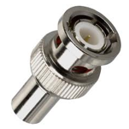


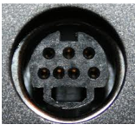
VIDEO CONNECTIONS
OLDER TECH
BNC
BNC to RCA phono adapater
RCA phono
S-video
Images from Google Images

Slide 10
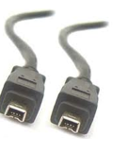
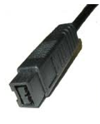
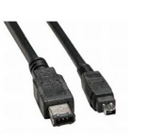
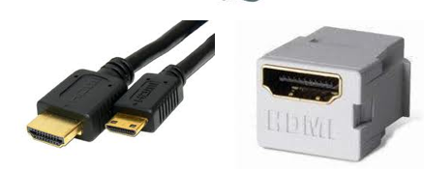
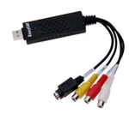
VIDEO CONNECTIONS
NEWER TECH
Firewire, IEEE 1394
Firewire 800
USB
HDMI

Slide 11
3 CAMERAS SPECIFICATIONS
Canon ZR80 – lower end
  Approx $250 new 8 years ago
  Shoots video to mini-DV
  Focal length = 2.8-50.4mm
  Image device = 340,000 pixels
  Output = 3.5mm mini-plug, firewire
  Inputs = firewire
Sony TRV11 – middle
  Approx $800 new 10 years ago
  Shoots video to mini-DV and still pictures to memory card
  Focal length = 3.3-33mm
  Image device = 680,000 pixels
  Outputs = 3.5mm mini-plug, firewire, headphones
  Inputs = S-video, firewire, microphone,
Canon GL2 – higher end
  Approx $1800 new 6 years ago
  Shoots video to mini-DV and memory card, still pictures to card
  Focal length = 4.2-84mm
  Image device = 1.2 million pixels
  Outputs = S-video, USB, firewire, 3.5mm mini plug, headphones
  Inputs – USB, firewire, microphone

Slide 12
CAMERA OPERATION
Movements
  Pan is to turn camera horizontally left to right or right to left
  Tilt is point camera up or down; need more headroom tilt up
  Dolly is to move the camera toward or away from object
  Truck or track is to move camera laterally
  Holding camera usually form the triangle keep elbows pressed against body
  Steady camera by steadying operator against wall; solid structure
  Position finger for zooming

Slide 13
CAMERA OPERATION
Operational features
  White-balance
    Teaching the camera what white is in the scene
    Adjusts RGB
    Many have auto white balance, some manually
    Manually means shoot a white piece of paper in every new lighting condition
  Focusing
    Auto-focus
  Zooming
  Presets for night, beach, fireworks, outdoors etc.

Slide 14
FRAMING A SHOT
Aspect ratio
  Relationship of width of screen to height of screen
  4 x 3 is typical of digital television
  16 x 9 typical of HDTV
Field of view
  How close the object seems to the viewer
  Video tends to be a close-up medium
Vectors
  Directional force with various strengths
  Graphic vectors like power lines, rows of homes
  Index vectors like arrows, one way street sign
    More definite direction that graphic
  Motion vectors like people walking, bird flying,

Slide 15
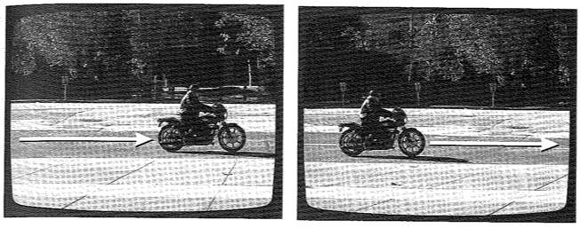
FRAMING A SHOT
Composition
  Subject or talent placement
  Headroom or leadroom
  Horizon line
Image from Zettl Video Basics 4

Slide 16
FRAMING A SHOT
Psychological closure

Slide 17
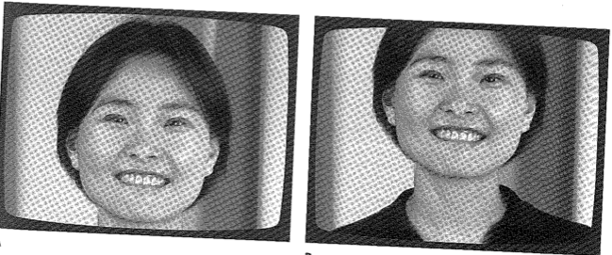
FRAMING A SHOT
Psychological closure
Image from Zettl Video Basics 4

Slide 18
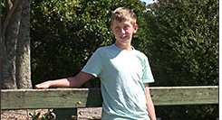
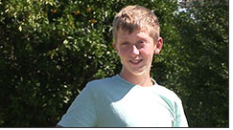
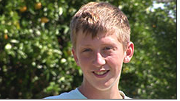
FIELD OF VIEW
Arrangement of elements on screen or in the shot
  Effects communication, emotional reaction, clarity
Mid shot
Medium close up
Image from mediacollege.com
Close up

Slide 19
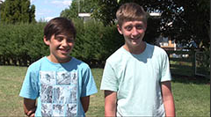
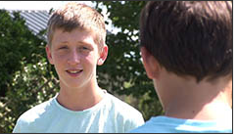
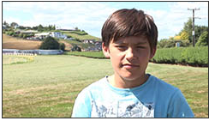
FIELD OF VIEW
2 shot
Over the shoulder
Reaction

Slide 20
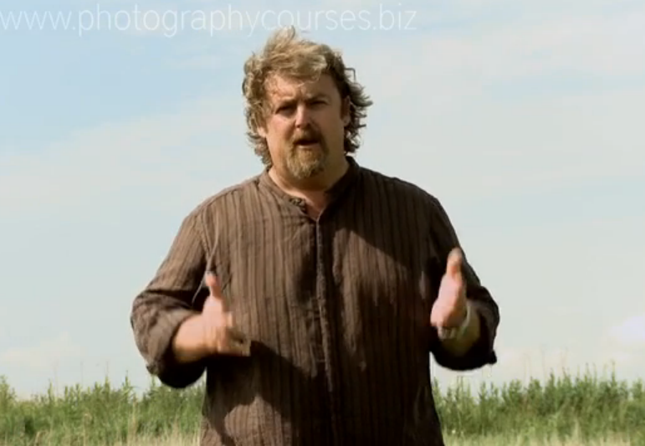
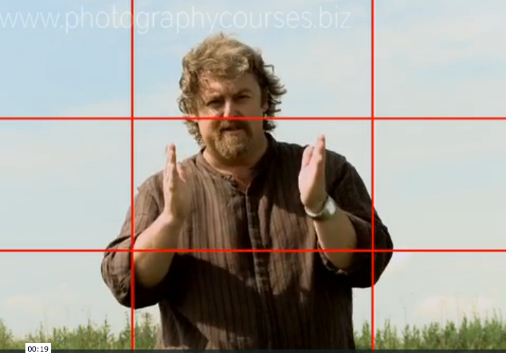
COMPOSITION
Rule of thirds
For a 1 shot
  Nose in the center
  Eyes in the upper third
  Watch the headroom
Image from Rules of Thirds on Vimeo

Slide 21
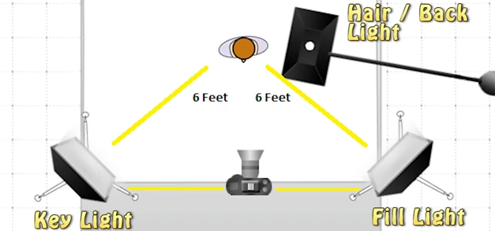
LIGHTING
Fundamental approach is 3 point lighting
  Uses 3 lights
  Used with interviews/talking head
Image from tubetape.com via youtube

Slide 22
LIGHTING
Key light
  The main light; lights your talent
  Most powerful of the 3 lights
Fill light
  Fills in shadows caused by key light
  Often about half as bright as key light
Back Light also known as Hair light
  From overhead
  Lights head and shoulders
  Aimed slightly behind talent
  Helps with separation from background
  Usually least powerful of 3 lights
http://www.youtube.com/watch?v=gkUqBJoxZ-I

Slide 23
LIGHTING
Not all lighting has the same color
Lighting and color effect video
Incandescent bulbs tend toward yellow/orange
Fluorescent tend toward light blue-green
Sunlight tends toward light to medium blue
  Depending on time of day
  Golden hour is hour before sunset and hour after sunrise

Slide 24
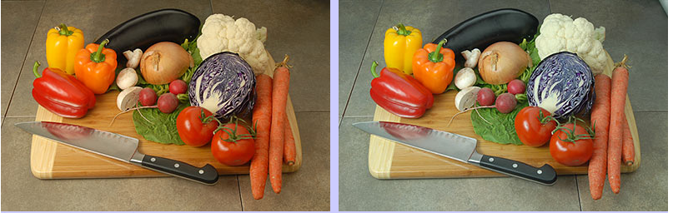
LIGHTING
Image from lowel.com
Both shot with natural daylight in room
Both shot with dv cam using daylight preset
Image on left also had professional lighting
Image on right also had household lighting
What are the differences?

Slide 25
MAGIC TRICK
Review trick procedures
Form either 3 groups of 5 or if we have additional
  Assign locations
  Handout camera and tripod
Within each group 3 roles; 1 per person
  Magician
  Assistant
  Camera operator
Shoot the trick 3 times so everyone has a turn at each role
Here, next door, 319, 330 or 336
Meet back here to watch and discuss tonight’s topics

Slide 26
NEXT SESSION
Next week is spring break
Video podcasts
iMovie introduction

